Slide 1
Software Reliability and Quality Control
Gu Qing
Nanjing University
2020年4月12日

Slide 2
Chapter 8. Applying Failure Data
Reliability Growth Test
Certification Test
Special Situations

Slide 3
2. Certification Test
Apply reliability demonstration chart to determine if
Continue the test
Reject the product or component
Accept the product or component
Failure intensity objective (λ_{F})
Expected number of failures per time or natural unit
Mean time to failure (MTTF)
Expected time that next failure will be observed
For exponential model (Poisson process), MTTF = 1/λ
Notes:
After current failure or start of running

Slide 4
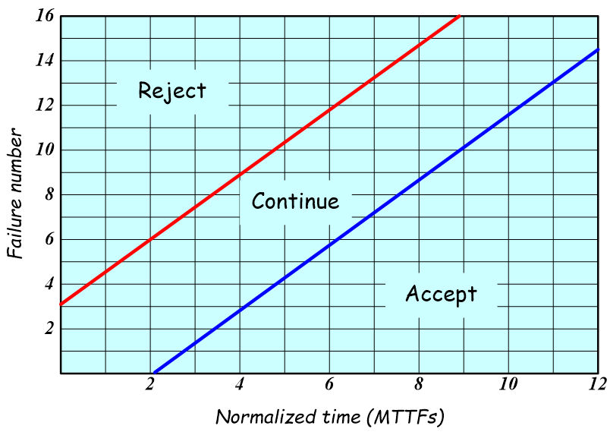
Reliability Demonstration Chart
Unit points when a failure occurred need recorded
Vertical axis (N)
Cumulative number of failures occurred
Horizontal axis (T)
Normalized time of failure
T = τ×λ_{F}
Number of target MTTF
Judge if FIO (λ_{F}) is met or not

Slide 5
Judge Parameters
Discrimination ratio (γ)
Acceptable error in estimating failure intensity
e.g. “γ =2” means actual failure intensity in λ_{F} /2~2λ_{F} will be accepted
Consumer risk (β)
Probability that the failure intensity is falsely accepted, i.e. “>γ ·λ_{F}”
Supplier risk (α)
Probability that the failure intensity is falsely rejected, i.e. “≤ λ_{F} / γ ”
Notes:
λ_{F} ~ 2λ_{F}

Slide 6
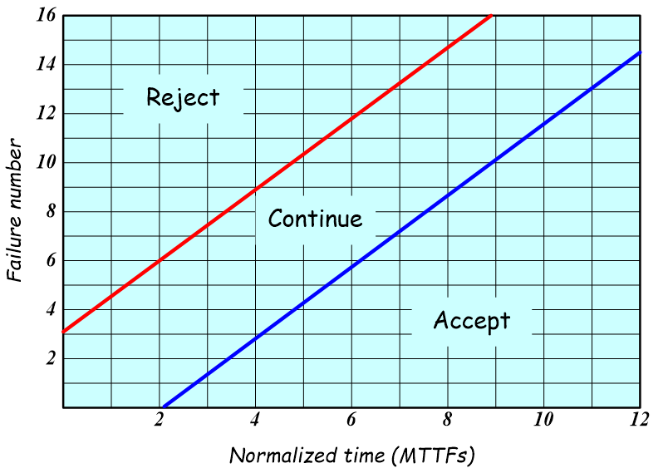
Example Demo Chart (1)
Discrimination ratio γ =2
Accepted failure intensity will be between 0.5λ_{F} ~ 2λ_{F}
Consumer risk β =0.1
10% risk of falsely accept a software when its failure intensity >2λ_{F}
Supplier risk α =0.1
10% risk of falsely reject a software when its failure intensity ≤0.5λ_{F}

Slide 7
Example Demo Chart (2)
The Fone Follower
The FIO (λ_{F})
4 failures per million calls
Failures in certification test
In fact, it can be accepted before failure 3
Failure No. | Measure (million calls) | Normalized time (MTTFs)
1 2 3 | 0.1875 0.3125 1.25 | 0.75 1.25 5
Accepted here

Slide 8
Interpret the Reliability Demo Chart (1)
2 boundaries
Continue-accept boundary
Boundary between continue and accept regions
Largely relates to consumer risk β
Continue-reject boundary
Boundary between reject and continue regions
Largely relates to supplier risk α

Slide 9
Interpret the Reliability Demo Chart (2)
Continue-accept boundary
B changes rapidly with consumer risk β, but slightly with supplier risk α, since risks <<1
Continue-reject boundary
A changes rapidly with supplier risk α, but slightly with consumer risk β
Note: when α = β, B = –A
α | 0.1 | 0.11 | 0.1 | 0.15 | 0.1
β | 0.1 | 0.1 | 0.11 | 0.1 | 0.15
B | -2.20 | -2.19 | -2.10 | -2.14 | -1.79
α | 0.1 | 0.1 | 0.11 | 0.1 | 0.15
β | 0.1 | 0.11 | 0.1 | 0.15 | 0.1
A | 2.20 | 2.19 | 2.10 | 2.14 | 1.79

Slide 10
Behind Reliability Demo Chart (1)
At normalized time point T, n failures sampled
Expected number of failures should be T
Consider Discrimination ratio γ
Then T/γ ≤ E(n) ≤ γ T
Let z = E(n)
For Poisson distribution

Slide 11
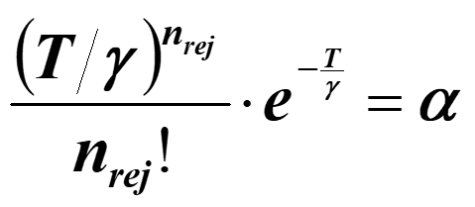
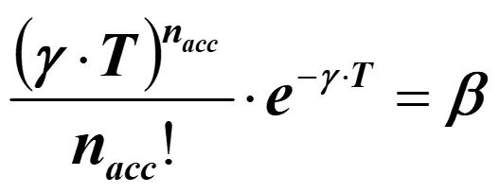
Behind Reliability Demo Chart (2)
For reject boundary
P{z ≤ T/γ ∧ n ≥ n_{rej}} ≤ α (Supplier risk), i.e. the up n_{rej}
For accept boundary
P{z ≥ γ T ∧ n ≤ n_{acc}} ≤ β (Consumer risk), i.e. the low n_{acc}
Notes:
M = λt

Slide 12
Behind Reliability Demo Chart (3)
Select a big (>>1) number e^{A}=(1–β) / α
Select a small (<<1) number e^{B}=β / (1–α)
Consider when n failures occurred, current time is τ
Let FIO = λ₀
Calculate d:
Accept if d ≤ e^{B}
Reject if d ≥ e^{A}
Notes:
A<0, B>0

Slide 13
Behind Reliability Demo Chart (4)
Let γ =λ₁/λ₀, then
For reject boundary
For accept boundary
Notes:
A<0, B>0

Slide 14
Some Useful Points
Continue-accept boundary
Intercept at horizontal axis
Intercept at vertical axis
Continue-reject boundary
Intercept at horizontal axis
Intercept at vertical axis
Notes:
A<0, B>0

Slide 15
Boundaries with Discrimination Ratio
Intercepts of boundaries at horizontal and vertical axes with various γ
Boundaries | Intercept with | Discrimination ratio γ
 |  | 2 | 1.5 | 1.1
Continue-accept | Vertical N_{acc}(0) | 1.44B | 2.47B | 10.5B
 | Horizontal T_{acc}(0) | –B | –2B | –10B
Continue-reject | Vertical N_{rej}(0) | 1.44A | 2.47A | 10.5A
 | Horizontal T_{rej}(0) | –A | –2A | –10A

Slide 16
Boundaries with Risk Levels
Values of A and B for various consumer and supplier risk levels
Supplier risk α | Parameter | Consumer risk β
 |  | 0.1 | 0.05 | 0.01 | 0.001
0.1 | B | -2.20 | -2.89 | -4.50 | -6.80
 | A | 2.20 | 2.25 | 2.29 | 2.30
0.05 | B | -2.25 | -2.94 | -4.55 | -6.86
 | A | 2.89 | 2.94 | 2.99 | 2.99
0.01 | B | -2.29 | -2.99 | -4.60 | -6.90
 | A | 4.50 | 4.55 | 4.60 | 4.60
0.001 | B | -2.30 | -2.99 | -4.60 | -6.91
 | A | 6.80 | 6.86 | 6.90 | 6.91

Slide 17
Regions and Parameters
When risk levels (α and β) decrease, the continue region becomes wider
The system will require more test before reaching the accept or reject regions
When discrimination ratio (γ) decreases, the continue region also becomes wider
The system will require more test before reaching the accept or reject regions

Slide 18
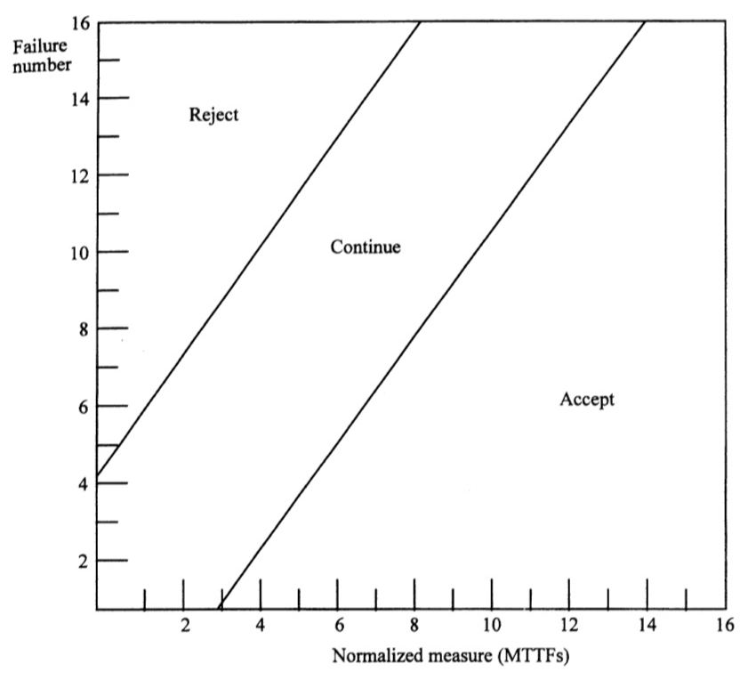
Regions and Parameters – Example (1)
Consumer risk
β = 5%
Supplier risk
α = 5%
Discrimination ratio
γ = 2

Slide 19
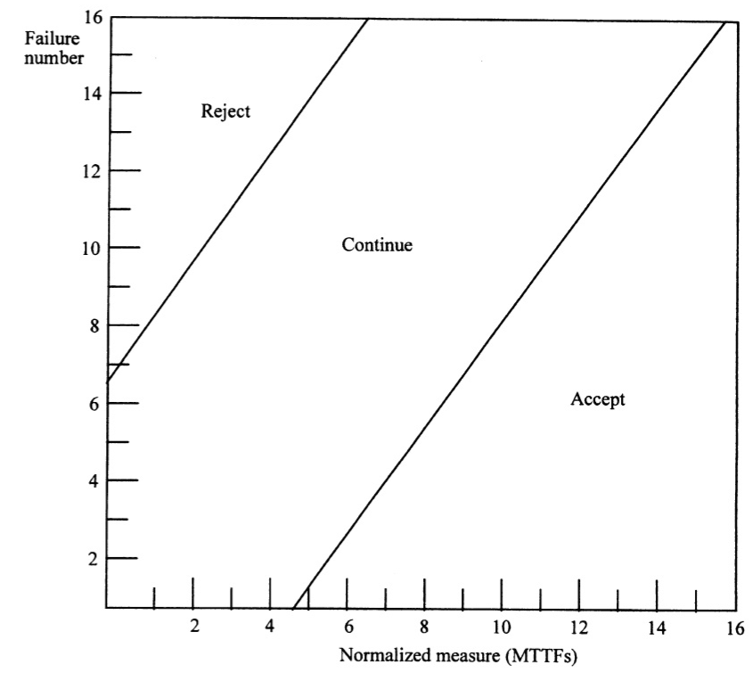
Regions and Parameters – Example (2)
Consumer risk
β = 1%
Supplier risk
α = 1%
Discrimination ratio
γ = 2

Slide 20
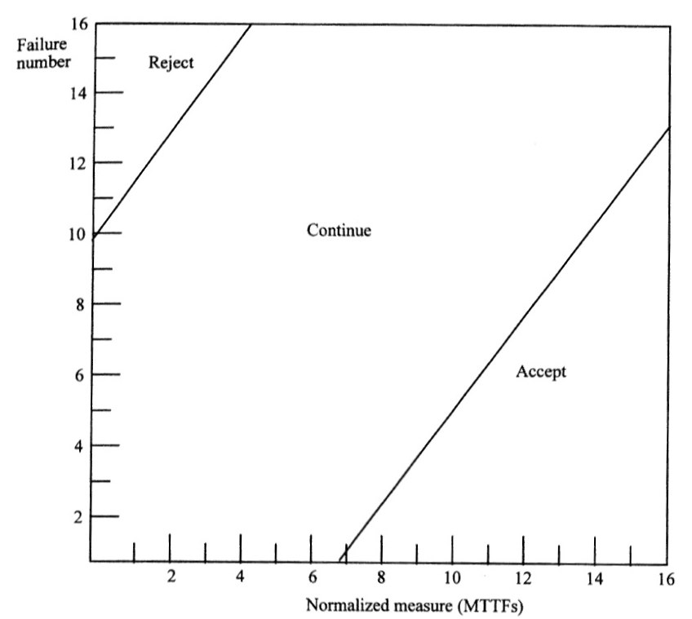
Regions and Parameters – Example (3)
Consumer risk
β = 0.1%
Supplier risk
α = 0.1%
Discrimination ratio
γ = 2

Slide 21
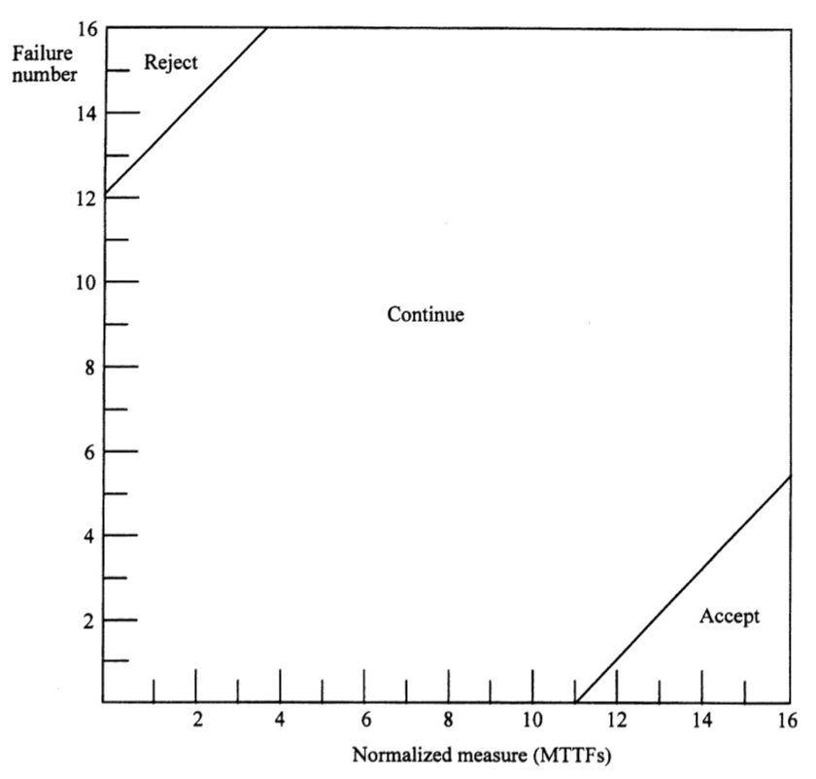
Regions and Parameters – Example (4)
Consumer risk
β = 10%
Supplier risk
α = 10%
Discrimination ratio
γ = 1.2

Slide 22
FI/FIO Ratio
The problem
If at end of certification test, failure data is still in continue region of reliability demo chart
Compute a demonstrable failure intensity to failure intensity objective (FI/FIO) ratio as a guide
Compute the FI/FIO ratio
n: number of failures occurred
T_{acc}(n): normalized time at continue-accept boundary for failure n
τ_{C}: number of time or natural units at end of certification test

Slide 23
FI/FIO Ratio – Judgment
Certification test for a component
If failures occurred, FI/FIO ratio is large (>5)
Reject the component
If FI/FIO ratio is small (<2)
Accept the component
Otherwise continue the test if possible, or risk may be high
Certification test for the product
If failures occurred, FI/FIO ratio is large (>5)
Return to reliability growth test, until reach a FI/FIO ratio of 0.5
If FI/FIO ratio is small (about 2)
Accept the product
Otherwise continue the certification test

Slide 24
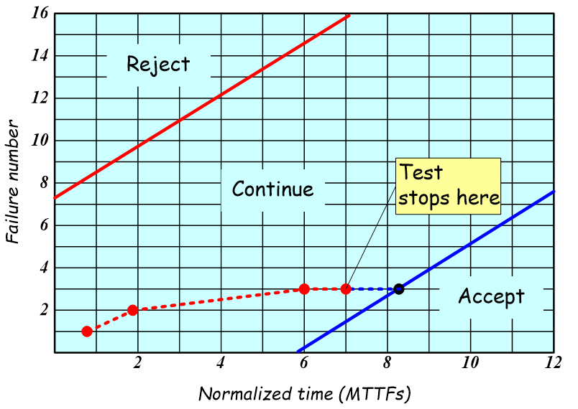
FI/FIO Ratio – Example
FIO for a product
λ_{F} = 0.1 failures per exec_hour
α = 5%
β = 5%
γ = 1.5
A = 2.94
B = -2.94
Failure number | Measure (exec_hour) | Normalized time (MTTFs)
1 | 8 | 0.8
2 | 19 | 1.9
3 | 60 | 6
For continue-accept boundary
Test stopped at normalized time 7
The product can be accepted

Slide 25
思考题
绘制可靠性判定表：
α = 10%，β = 10%，γ = 1.5
计算A、B和两个边界的坐标点
结合失效记录在判定表中标记
尝试其他的组合，如
α = 5%，β = 5%，γ = 2等

Slide 26
Summary
Reliability Growth Test
FI/FIO ratio: concepts, estimation, judgments
Certification Test
Reliability demonstration chart: regions and parameters, judgments
Special Situations
Evolving programs, Unreported failures, Operational profile variation

